Slide 1
Computer Systems and Networks
ECPE 170– University of the Pacific
Linux Basics

Slide 2
Operating System Tasks
What does the OS need to do?
Schedule processes to run
Memory management
Interrupt handling (manage hardware in general)
Security (between processes)
Network access
Storage management (filesystem)
Graphical user interface
May be a middleware layer on top of the OS

Slide 3
Operating Systems – Processes
Process management is a key operating system task
OS must initially create processes when you run your program
OS can allow processes to access resources
Must schedule access to shared resources (e.g., CPU)
OS can allow processes to communicate with each other
OS must clean up after process finishes
Deallocate resources (e.g. memory, network sockets, file descriptors, etc…) that were created during process execution

Slide 4
Operating Systems – Scheduling
The operating system schedules process execution
What processes are allowed to run at all?
What processes are allowed to run right now?
Context switches occur when the CPU is taken from one process and given to another process
CPU state (registers, current PC, etc…) is preserved during a context switch

Slide 5
Operating Systems – Scheduling
Preemptive Scheduling
Each process is allocated a timeslice
When the timeslice expires, a context switch occurs
A context switch can also occur when a higher-priority process needs the CPU

Slide 6
Operating Systems – Security
Process A is forbidden from reading/modifying/writing the memory of Process B
Virtual memory is a huge help here!
Each process has a separate virtual address space that maps to different regions of physical memory
Process A has other limits besides which memory pages it can access
What are some other limits?
Amount of memory consumed
Number of open files on disk
Which files on disk can be read/written

Slide 7
Operating Systems – Filesystem
OS is responsible for managing data on persistent storage
Job of the filesystem!
What files exist? (i.e. names)
How are they organized? (i.e. paths/folders)
Who owns and can access them? (i.e. usernames, permissions)
Where are individual file blocks stored on the disk?
i.e. filename “database.dat” is really composed of 15823 blocks, of which block 1 is located at logical block address #... on the hard drive.

Slide 8
Operating Systems – Device Management
Manage devices
How do we send data to the NIC for transmission?
How do we render an image for display on screen?
How do we read a block of data from our RAID disk controller?
Operating systems can be extended through device drivers to manage new hardware
Hardware vendors write software to manage their devices
OS provides a fixed interface (API) that driver must follow
Common task for a device driver is responding to interrupts (from that device)

Slide 9
Operating Systems – The Kernel
Who does all this essential work in the operating system? (besides the GUI)
The kernel (i.e. the heart or core of the OS)
Kernel performs:
Scheduling
Synchronization
Memory management
Interrupt handling
Security and protection

Slide 10
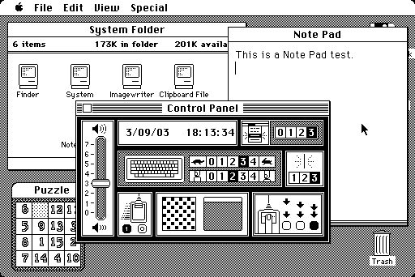
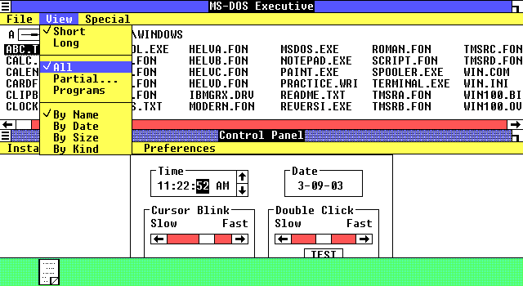
Operating Systems – GUI
Operating systems with graphical user interfaces (GUI) were first brought to market in the 1980s
Microsoft Windows 1.0 (released 1986)
Apple Mac OS 1.0 (released 1984)
Captures from http://www.guidebookgallery.org/screenshots

Slide 11
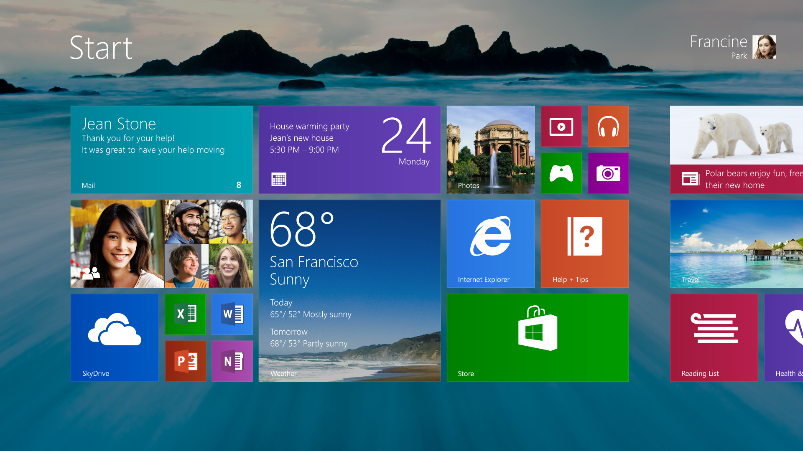
Significant evolution in GUI design in subsequent decades

Slide 12
Operating Systems – GUI
Technical perspective:
The GUI is one of the least important parts of the operating system
A GUI does not even have to be part of the true OS at all
Windows 1.0 was just a program that ran on top of MS-DOS, the true operating system (of that era)
But to a user, the GUI is one of the most important parts of the OS!

Slide 13
Linux Command Line

Slide 14
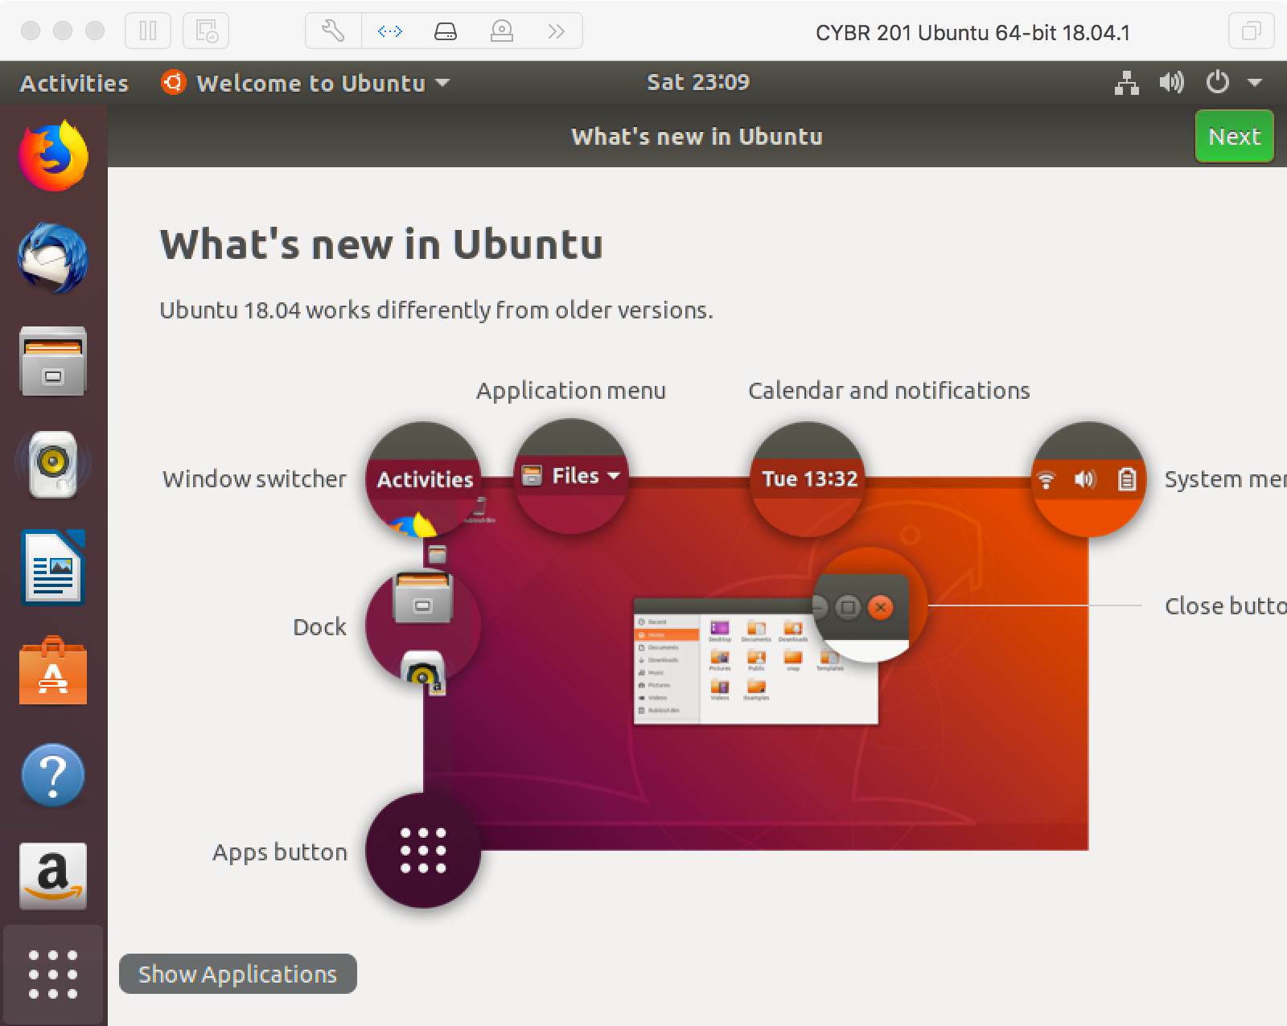
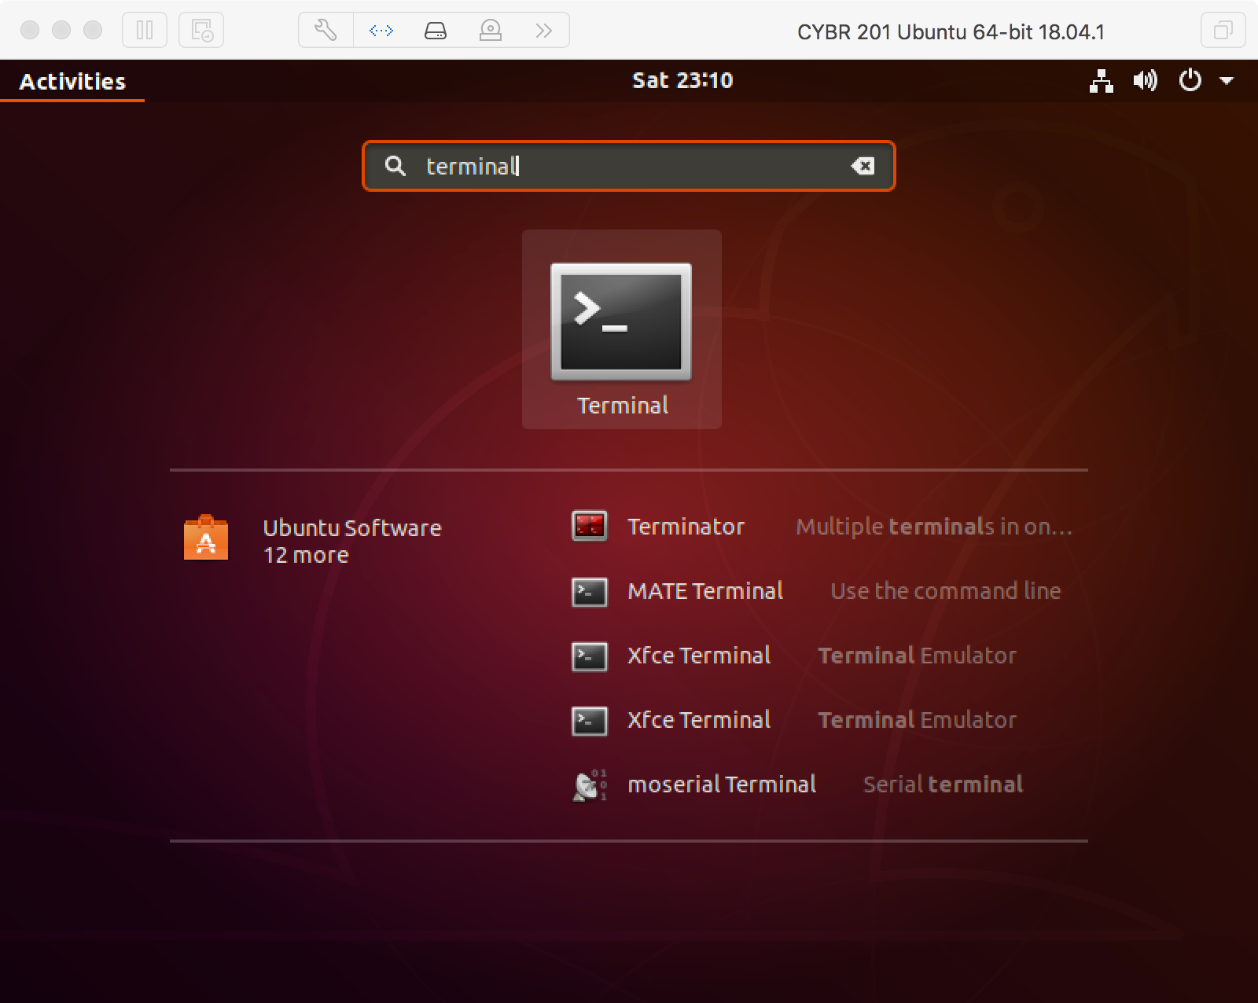
In-Class Activity
Launch your Linux virtual machine!
Open the Terminal – a text-based interface that accepts your commands (Applications button -> Terminal)
Open Canvas and today’s In-Class Participation assignment

Slide 15
Problem 1 – Which Shell?
A shell is a user program that defines how your terminal window behaves for input commands
Command-line interpreter
Parses user input and carries out commands
Many types exist: sh, bash (Bourne again), C syntax motivated: csh, tsh, etc.
Find out what shell is being used:
$ echo $SHELL
P1

Slide 16
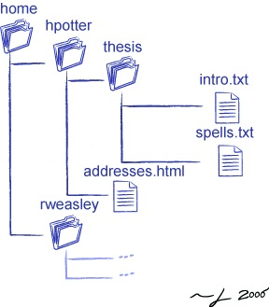
Directory Structure
Root directory: /
Absolute path:
/home/hpotter/thesis/intro.txt
Relative path:
If I am already in /home/potter/
addresses.html
http://osl.iu.edu/~pgottsch/swc2/lec/shell01.html

Slide 17
Problem 2 – Navigation Skills
Where are we?
What items exist here?
$ pwd
Print Working Directory
$ ls
List items
$ ls [options] [location]
List the 10 items in /etc/ folder
P2

Slide 18
Basic Operations
Tilde (~) sign refers to your home directory. You can perform either
$ ls /home/you/Documents
$ ls ~/Documents

Slide 19
Navigation Skills
Dot (.) sign refers to current directory. Try:
Double dot (..) refers to the parent directory of your current directory. Try:
$ ls .
$ ls ..

Slide 20
Problem 3 – Navigation Skills
Change directory
Hint: There’s a very easy shortcut to change directory to your home directory…
$ cd [location]
P3
Change the directory to /etc/.

Slide 21
Problem 4 – Documentation
Documentation (“manual”) on commands
Example usage
Hidden files have a (.) before the filename
.secret, .bashrc, …
Type ls – Do you see any hidden files?
Using the man command, find out what option you need to use with ls to list the hidden files
$ man [command]
P4
$ ls -a
List the files sorted by size.

Slide 22
Basic Operations
Create a directory called Linux_tutorial inside your home directory
Change to the Linux_tutorial directory
Create a blank file called example1
Do these steps in your VM!
$ mkdir [options] [dirname]
$ touch example1

Slide 23
Basic Operations
Put something in the file via output redirection
Copy file example1 to example2
Move the example2 file to your home directory
$ echo "Tiger Roar" > example1
Do these steps in your VM!
$ cp example1 example2
$ mv example2 ~

Slide 24
Basic Operations
Do this step in your VM!
Remove the file example2
General form of command
$ rm ~/example2
$ rmdir [options] [dirname]
$ rm [options] [filename]

Slide 25
Piping
Do this step in your VM!
Change to /etc directory and count the number of files in that directory. You only have 60 seconds. Tick tock!!
Tip: Combine list tool with another tool that will count the number of words (or lines)
$ cd /etc
$ ls -l | wc -l
Pipe
Word Count
Option: Count number of lines

Slide 26
Problem 5 –Wildcards
Directory listings can use wildcards to search for matching file names
Example: In /etc directory, list all files with .conf extension
Example: In /etc directory, list all files where second letter is d and with .conf extension
$ ls *.conf
* – Zero or more characters
? – Single character
[] – Range of characters
$ ls ?d*.conf
P5
Give the command to list the files with the word 'switch' in them.

Slide 27
File Permissions
Linux provides you privacy with files via permissions
r read – the contents of the file can be viewed
w write – something can be written to the file
x execute – the file can be executed if an executable or script
Permission is granted to three types of people
owner – the one who created the file, also called user (u)
group – the file belongs to a single group (g)
others – everyone else (o) but the group or the owner

Slide 28
Problem 6 – File Permissions
Create the requested file with the requested contents, and obtain a directory listing…
-rw-rw-r-- 1 shafer shafer 18 Sep 4 14:40 example3
owner has read and write permissions, but not execute
group has read and write permissions, but not execute
others have read only permissions
Change to your home (~) folder. Perform this command:
echo 'cat /proc/cpuinfo' > example3.
Find the permissions to the file example3 and write it down.
P6

Slide 29
File Permissions
The example3 file can’t be executed – try it:
$ ./example3

Slide 30
Problem 7 – File Permissions
$ chmod [permissions] [file]
Changing the file permissions requires answers some questions
Whose permissions are we changing?
[ugoa]: owner, group, others, or all
Are we granting or revoking permission?
+: providing -: revoking
What are we providing?
r (read), w (write), or x (execute)
$ chmod u+rwx file
Provides rd/wr/ex to owner
$ chmod g-x file
Removes ex for group
P7

Slide 31
Shell Shortcuts
<TAB> key to auto-complete commands
<UP ARROW> key to cycle through previous commands
These two tips make your life so much easier!

